Slide 1
Inferring clonal composition of a breast cancer from multiple tissue samples
Habil Zare
Department of Genome Sciences
University of Washington
19 Dec 2013

Slide 2


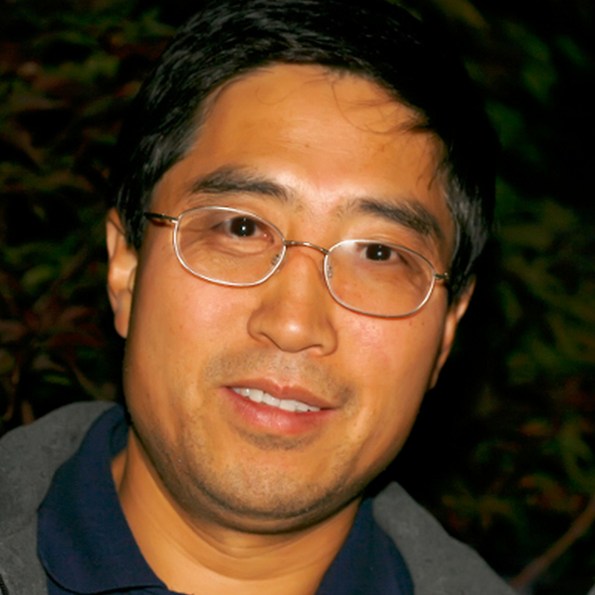
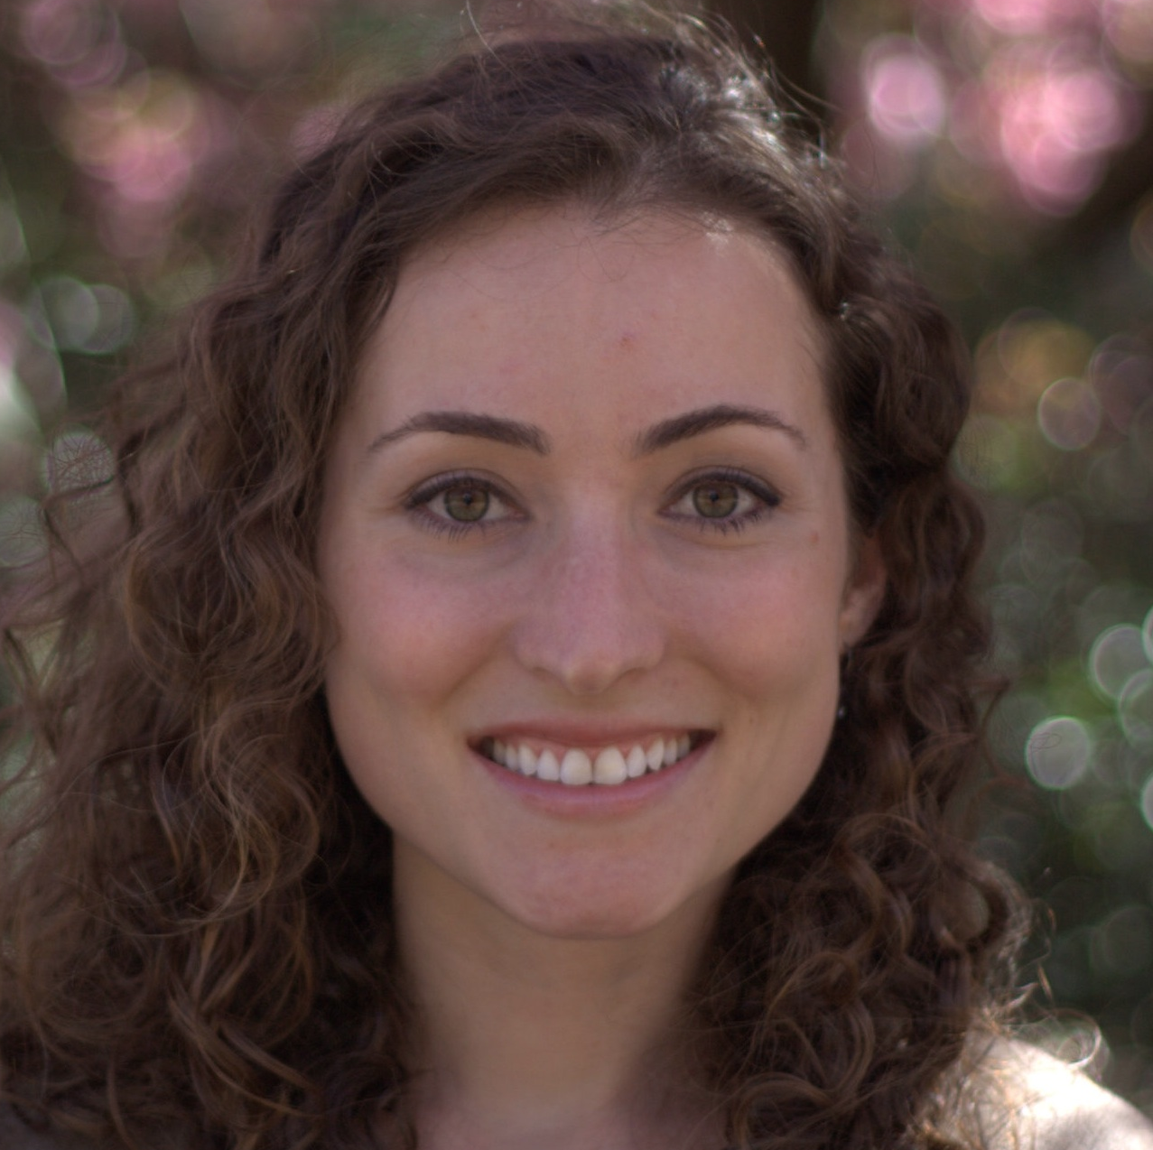

A highly collaborative study
(The University of Washington)
Dr. Anthony Blau, MD
Oncologist
Dr. Junfeng Wang, MD
Oncologist
Dr. ChaoZhong Song, MD
Lab scientist
Dr. Daniela Witten, PhD
Biostatistician
Dr.William Noble, PhD
Computational Biologist

Slide 3
Hypothesis
Because cancer is a heterogeneous disease, synergistic medications can treat it better than a single drug.

Slide 4
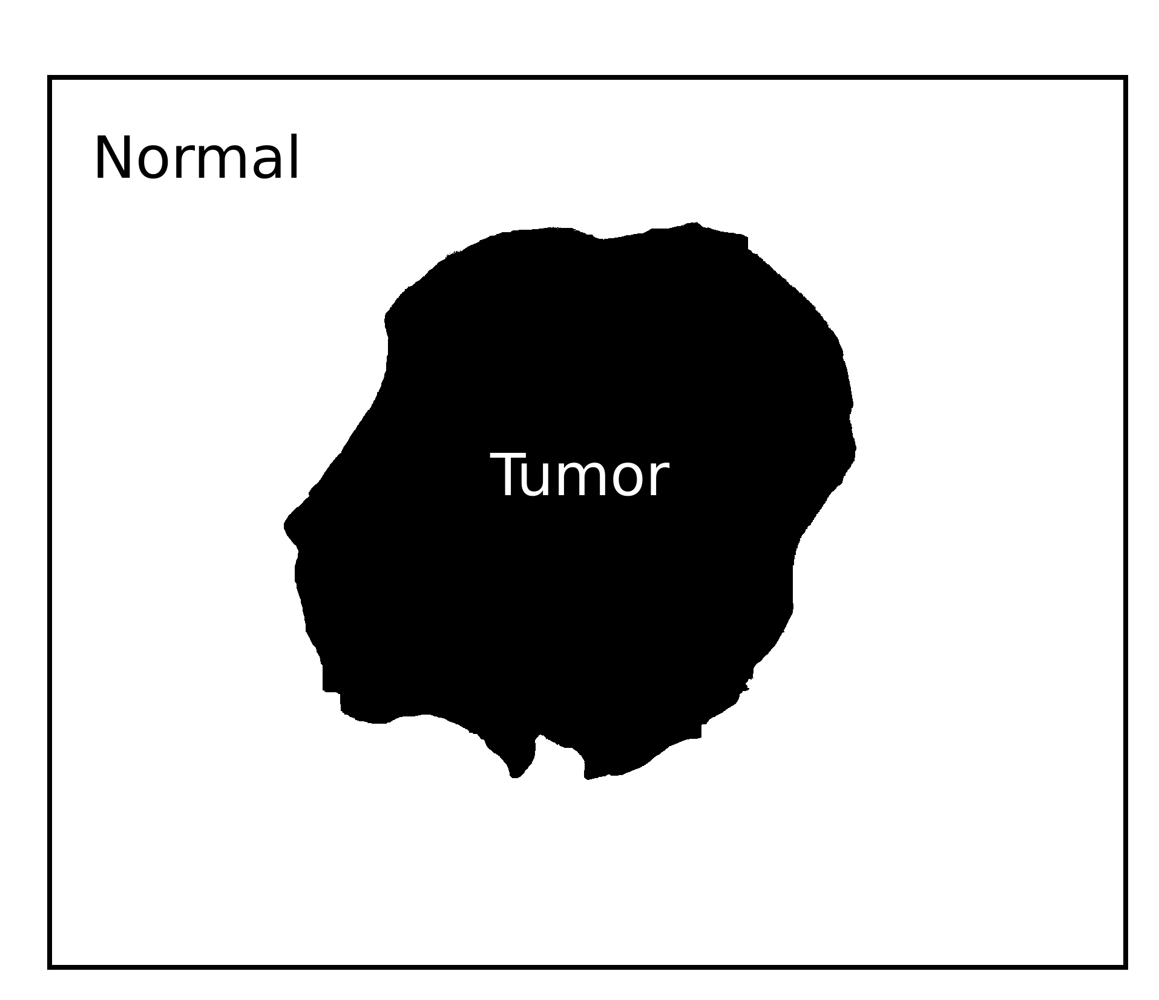
Traditional concept of a tumor
Schematic figure

Slide 5
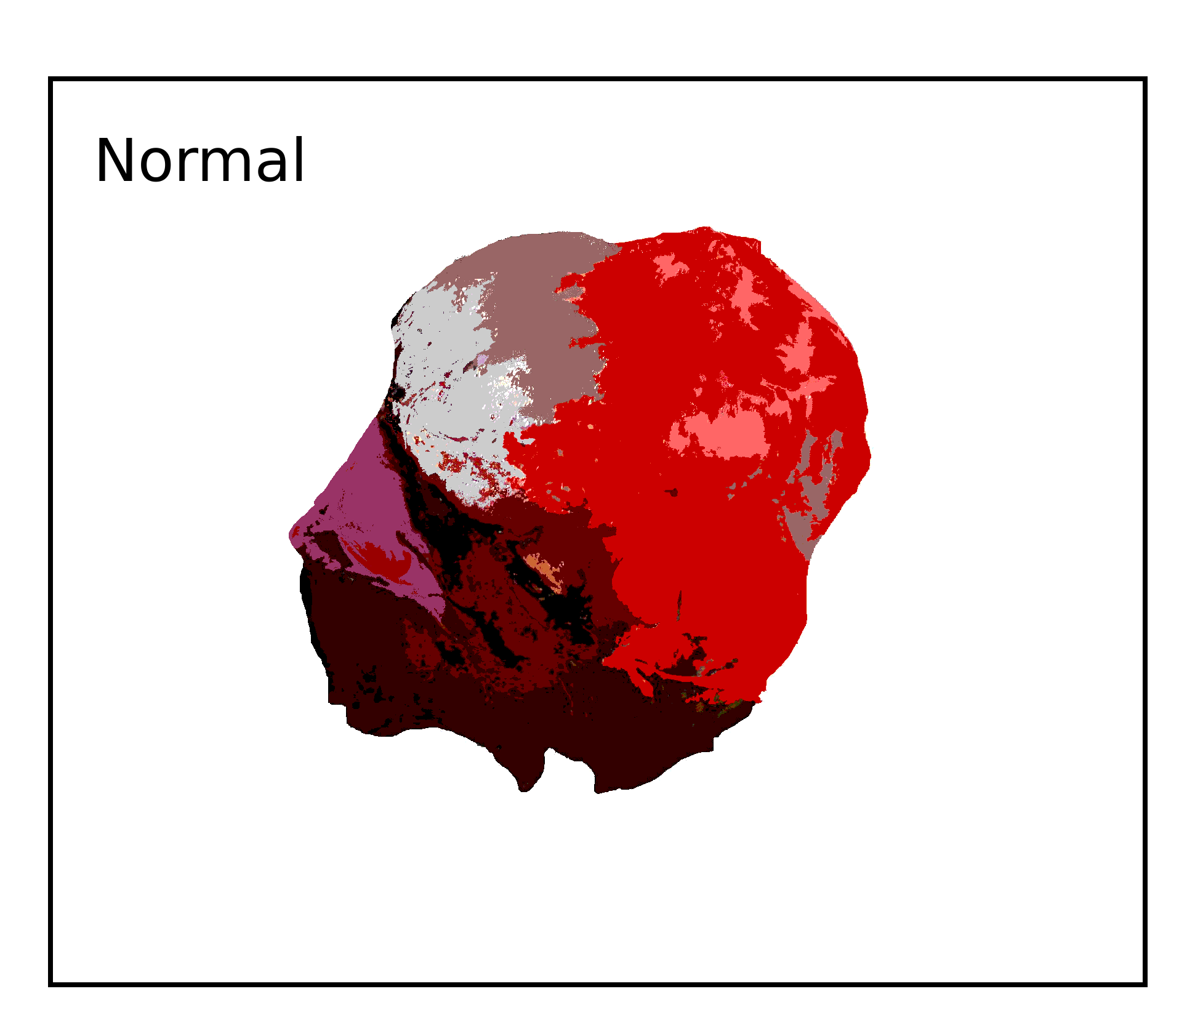
Most tumors are heterogeneous
Schematic figure

Slide 6
Different clones have different genotypes and phenotypes
Clone 1
Clone 2
Clone 6
Clone 3
Clone 5
Clone 4
Schematic figure

Slide 7


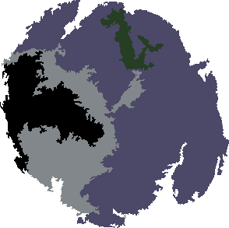

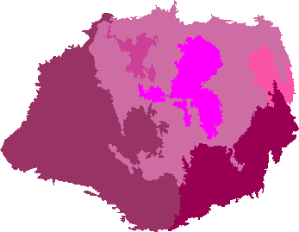
It is important to identify the clonal composition
Treatment A
Relapse
Treatment B
Relapse

Slide 8
It is important to identify the clonal composition
?

Slide 9
It is important to identify the clonal composition
?

Slide 10
Our approach to analyze multiple samples from a single tumor

Slide 11
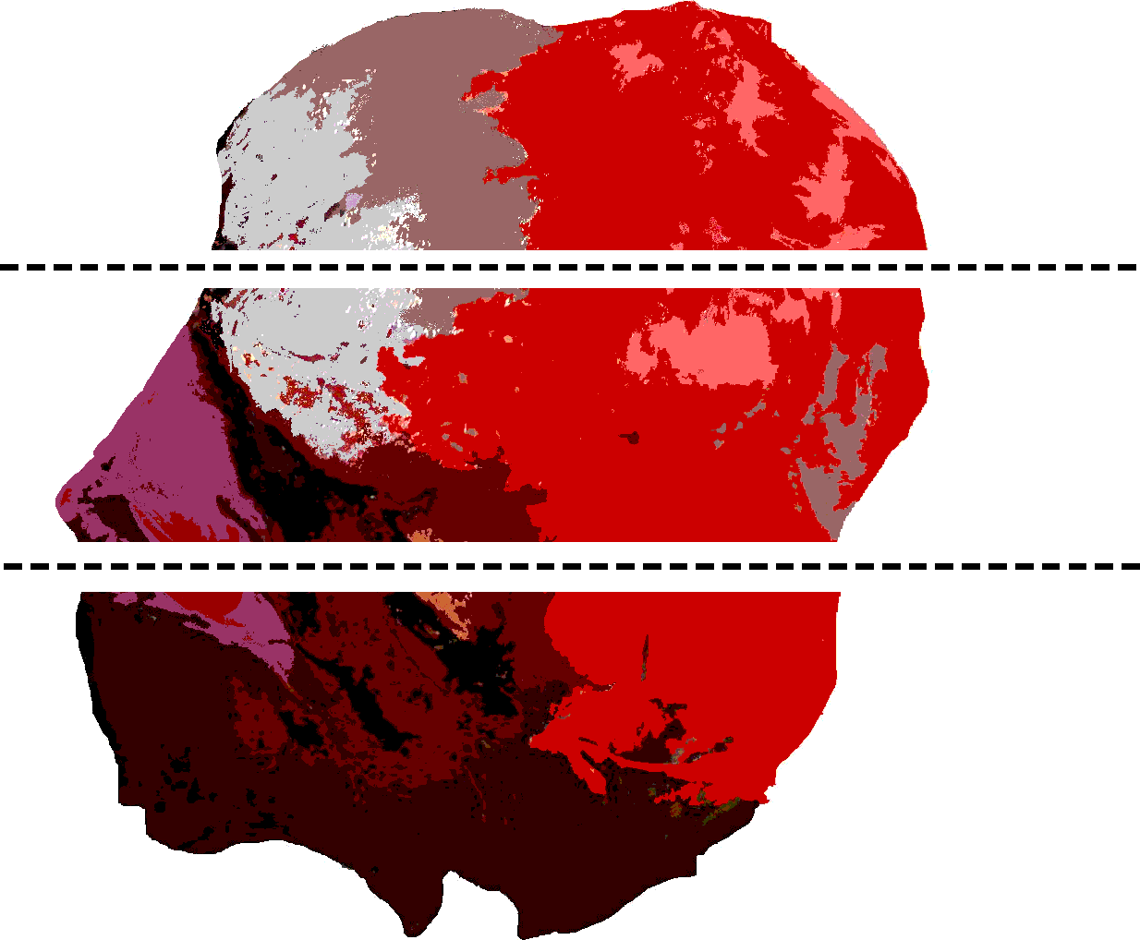
Our approach to analyze multiple samples from a single tumor

Slide 12




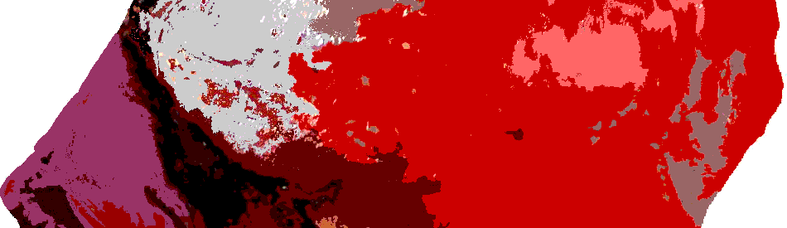


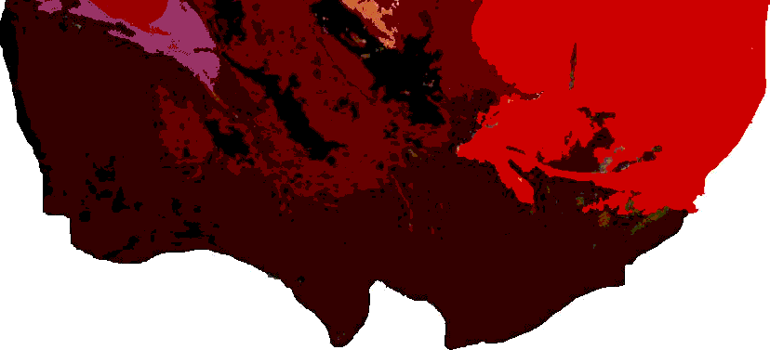

Each sample has different information about the clonal composition
Counting the number of reads which support each mutation
PCR
Next Gen
Sequencing
PCR
Next Gen
Sequencing
PCR
Next Gen
Sequencing

Slide 13
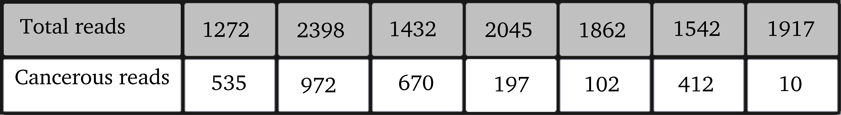
A closer look at the Next-Gen Sequencing output
How to use this variation to infer the clonal composition?
At each locus, 2 integers are provided:
total number of analyzed reads, and
the number of reads supporting the mutation.
Because different clones have different contributions to each sample, these numbers vary across the samples.

Slide 14
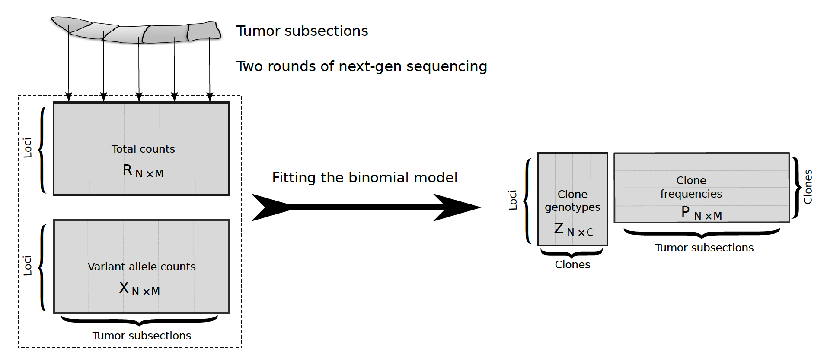
The observations
Building a generative model
Tumor
The observations boils down to the number of reads which support each allele.
M samples
Mutations on N loci

Slide 15

Building a generative model
Given the parameters, how to generate data?
Data
Generate
Parameters

Slide 16
Building a generative model
Given the parameters, how to generate data?
Data
Generate
?
Parameters

Slide 17
Building a generative model
Generate
?
Parameters

Slide 18

The main assumption on the distribution of reads
Building a generative model
Mutation i can be present or absent in each clone
Assumption:
Reads are analyzed uniformly at random
=> Binomially distributed
Project on
Mutation i

Slide 19

The main assumption on the distribution of reads
Building a generative model
Mutation i can be present or absent in each clone
Number of reads exhibiting the variant allele at locus i in sample j.
Project on
Mutation i
Assumption
Total number of reads
Frequency of variant allele

Slide 20

A close look at the binomial distribution
Building a generative model
Number of reads exhibiting the variant
Observed
Total number of reads
Observed
?
Frequency of variant allele
depends on:
Which clones contain mutation i ?
What is the frequency of those clones in sample j ?

Slide 21
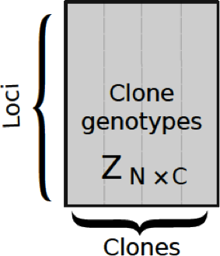
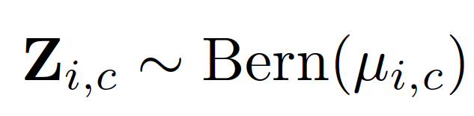
Introducing the hidden variables
Building a generative model
depends on:
Which clones contain mutation i ?
What is the frequency of those clones in sample j ?
If Z_{i,c} = 1, clone c has a variant allele at locus i.

Slide 22
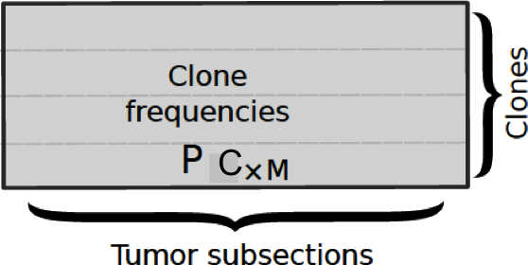
Notation for the model parameters
Building a generative model
depends on:
Which clones contain mutation i ?
What is the frequency of those clones in sample j ?

Slide 23
Building a generative model
?
Generate
Parameters
C

Slide 24
The assumptions in brief
Building a generative model
Each mutation can occur at a locus independently at random.
The samples are independent from each other.

Slide 25
The model makes a few key assumptions
If Z_{i,c} = 1, then clone c has a variant allele at locus i.
The number of clones (C) is given.
In each sample, each locus is either homozygous normal or heterozygous normal/variant.
Clones are drawn according to a Bernoulli distribution
Observed reads are drawn according to a binomial distribution.
Number of reads exhibiting the variant allele at locus i in sample j.
Total number of reads
Frequency of variant allele

Slide 26
Building a generative model
Technical
Generate
Parameters
C

Slide 27
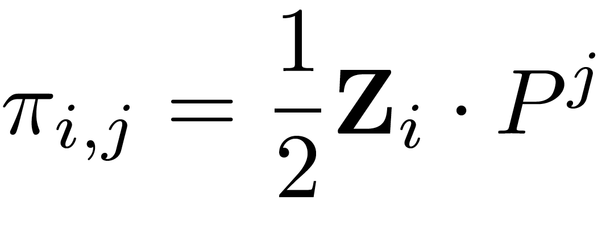
Overview of the generative model from parameters to the observations
Parameters
C
Observations

Slide 28
Inference
Given the observed counts, how do we infer the clonal structure?
Technical
EM
Inference
C

Slide 29


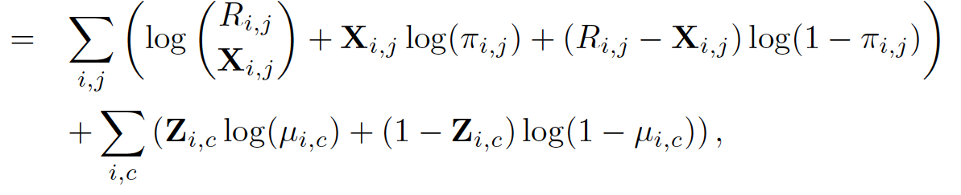
We infer model parameters using expectation-maximization
Derived from the binomial distribution
Technical details
Derived from Bernoulli distribution

Slide 30
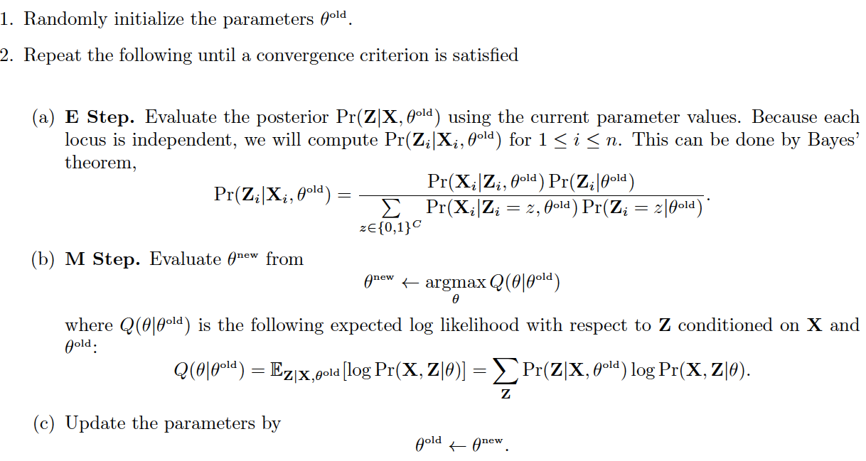
EM overview
Technical
Initialization
Iteration loop
E Step
M Step
Parameters update

Slide 31

Some details of EM for my model
Technical
Initialization
Iteration loop
E Step
More challenging...
M Step
Parameters update

Slide 32


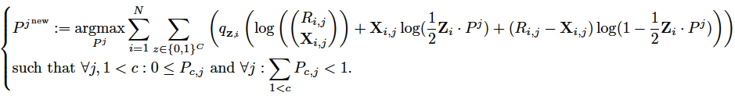
M step
Technical
Solve the following optimization problem
BFGS-B was used

Slide 33
How can we evaluate whether the model works?
Two rounds of next gen sequencing
Inference
C

Slide 34

We do not know the reality
~
Inferred
Reality

Slide 35
Generating synthetic data
Generate
Inference
`
C

Slide 36
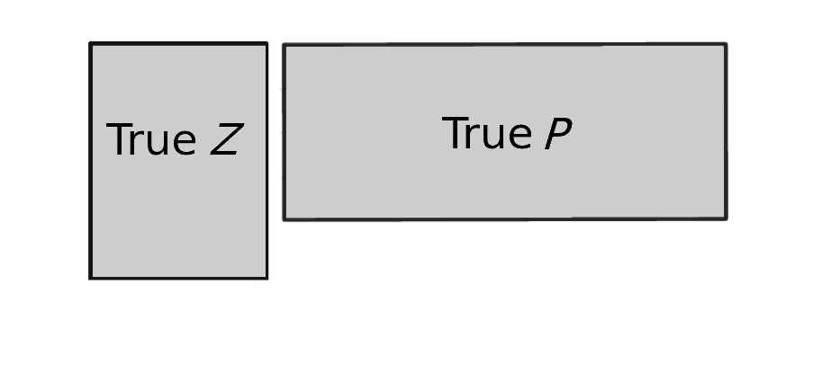

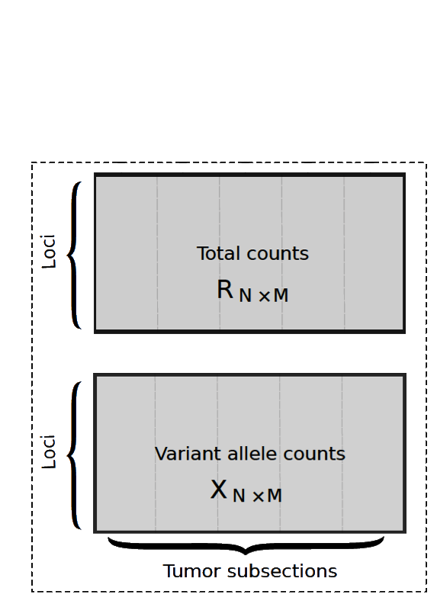
Generating synthetic data
Generate
Random parameters
compare
Inference
C

Slide 37
Defining accuracy criteria
Genotype error:
The frequency of false entries in the genotype matrix Z
Clone frequency error:
The average error in entries of the frequency matrix P

Slide 38
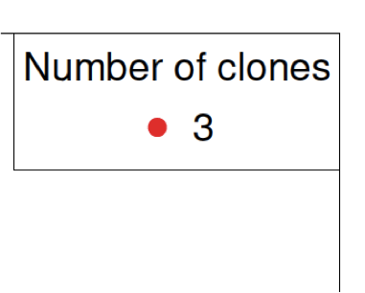
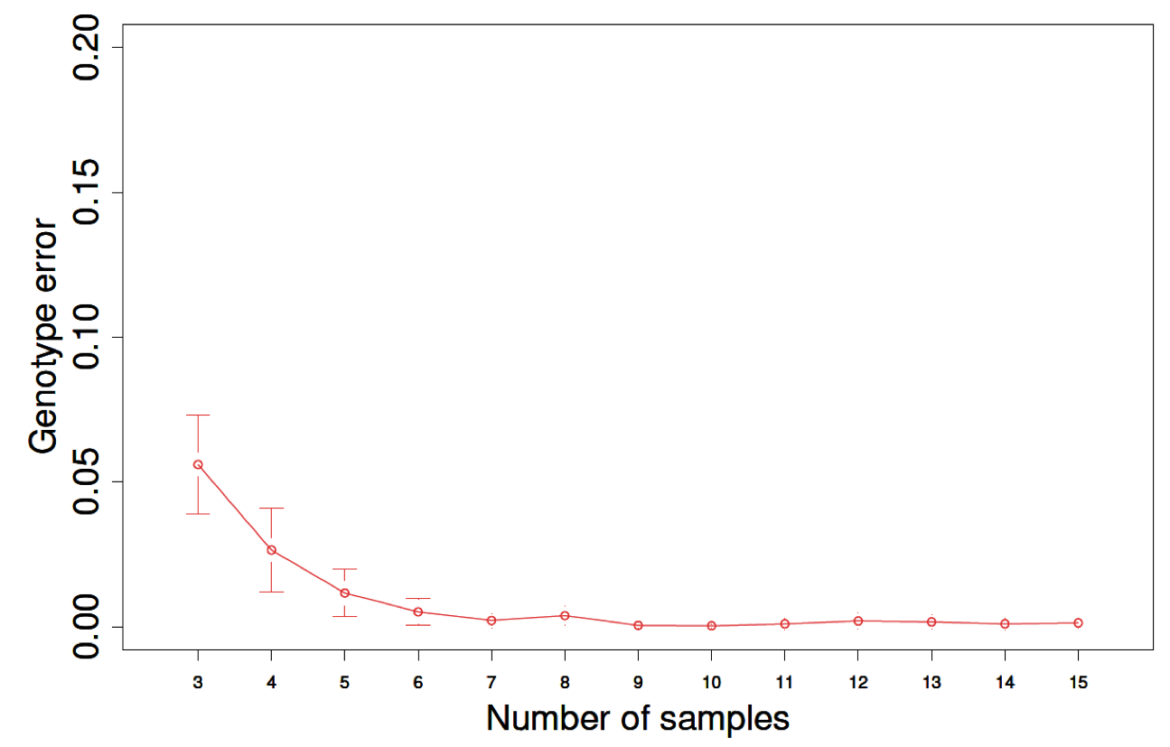
Simulation shows genotype error decreasing with increasing samples

Slide 39
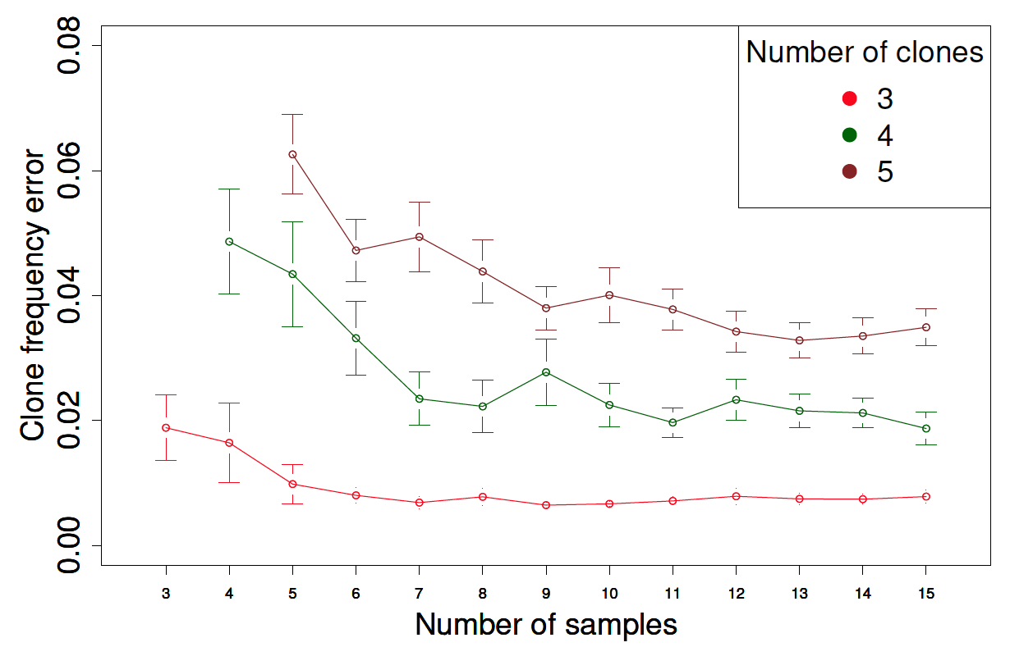
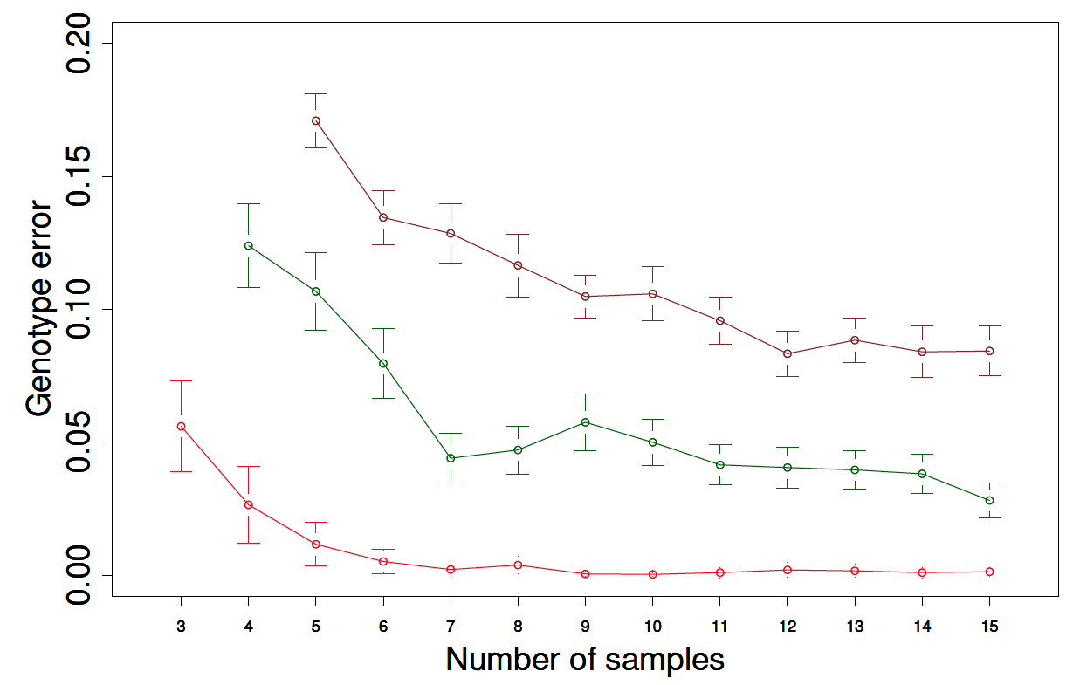
Simulation shows genotype error decreasing with increasing samples

Slide 40
Clone frequency error shows a similar trend

Slide 41
Experiment with real data
Study on a primary breast cancer
10 breast tumor samples
1 adjacent normal
2 samples from the metastatic lymph node
M1
P1
P2
P3
Notes:
Maybe move tis slide and the next one, with a plot of frequencies, to earlier.

Slide 42
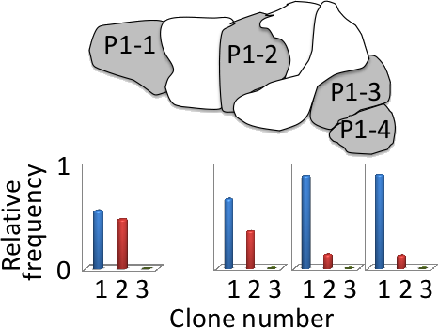
Clone frequencies vary smoothly across the tumor sections
The model doesn’t know anything about the anatomic location of the samples!

Slide 43
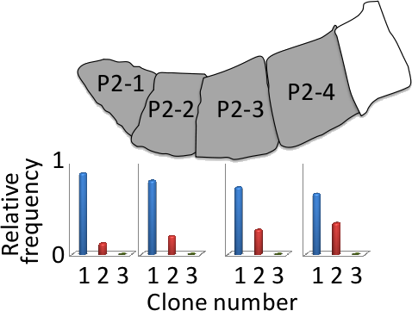
Clone frequencies vary smoothly across the tumor sections

Slide 44
Phylogenetic analysis
tells the story of the tumor over time

Slide 45
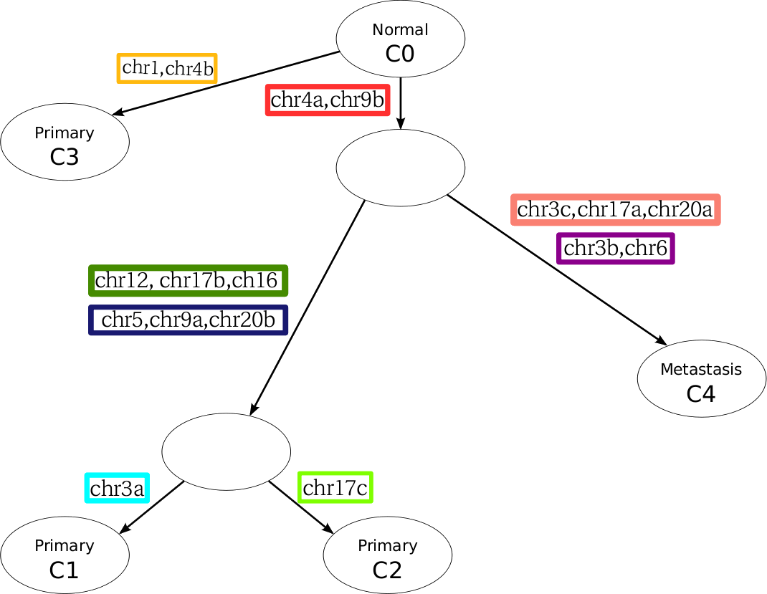
Five clone solution

Slide 46
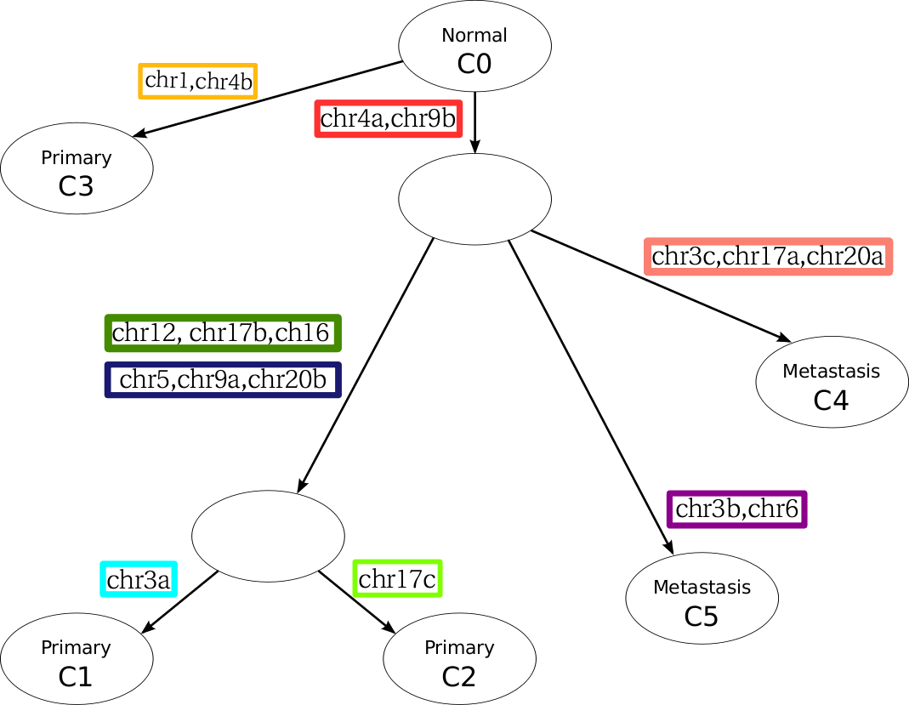
Six clone solution is consistent with five-clone solution

Slide 47
Overview of the project
Inferring clonal composition of a breast cancer from multiple tissue samples
Oncologists
Anatomic variation of clones
Phylogenetic trees
EM
Validated by simulations
Next-Gen Sequencing Data
Clonal structure
Notes:
47

Slide 48

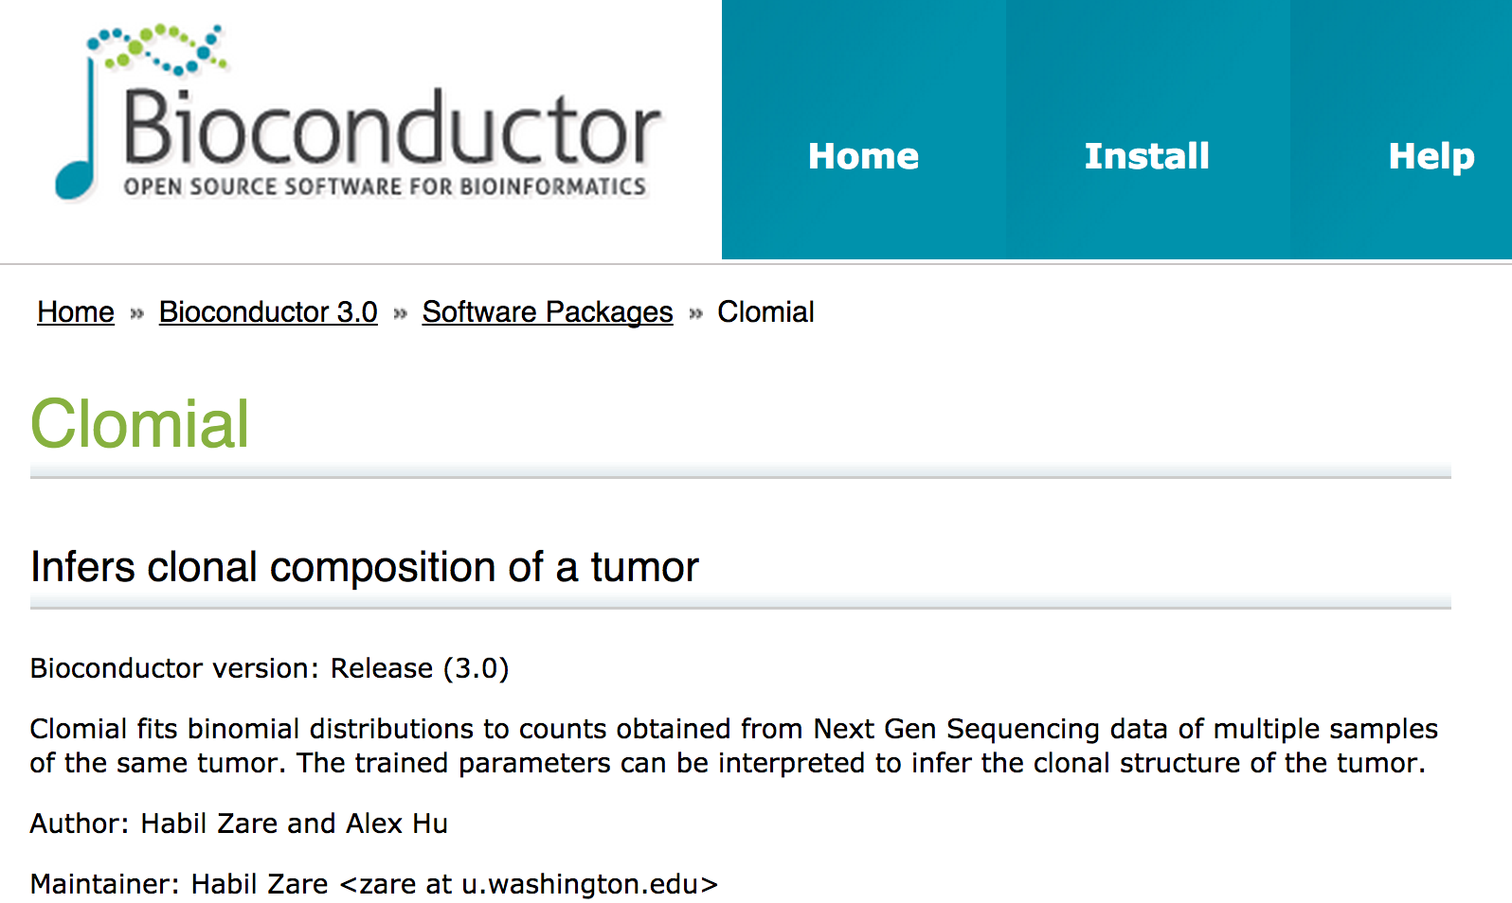
Software publicly available
Notes:
48

Slide 49
Supplementary slides

Slide 50
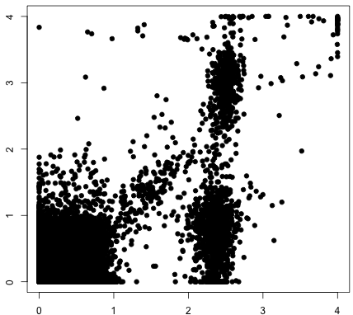
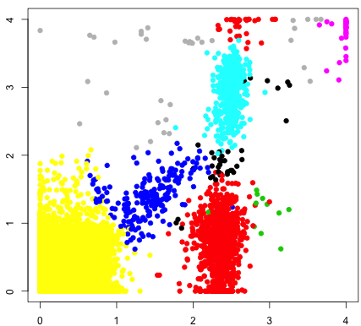

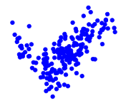


Proposed project based on former experiences:
Identifying clonal decomposition using sub-tissues
SamSPECTRAL
Leukemia or lymphoma sample
Next Gen Sequencing
Sort
cell populations
Next Gen Sequencing
Clonal
analysis
Next Gen Sequencing
Next Gen Sequencing
Notes:
50

